Slide 1

Software Engineering and Professional Practice & Building Usable Software Dr. Rami Bahsoon School of Computer Science The University Of Birmingham r.bahsoon@cs.bham.ac.uk www.cs.bham.ac.uk/~rzb Office 112 Y9- Computer Science
Unit 1. Introduction to Software Lifecycle and Process Models

Slide 2
Brainstorming Exercise
What is your understanding of a “Software Process”?
Have you used any “Software Process Model” in your practice?
Which models?
Examples?
Uses? Strengths/Weaknesses?
Observations?

Slide 3
Software Engineering – for Orientation
Software Engineering is a branch of systems engineering concerned with the development of large and complex software intensive systems. It focuses on:
the real-world goals for, services provided by, and constraints on such systems,
the precise specification of systems structure and behaviour, and the implementations of these specifications,
the activities required in order to develop an assurance that the specifications and real world-world goals have been met,
the evolution of these systems over time, and across systems families,
It is also concerned with the processes, methods and tools for the development of software intensive systems in an economic and timely manner.
Reference: A. Finkelstein

Slide 4
Software Process
A structured set of activities required to develop a software system
Specification;
Design;
Validation;
Evolution.
A software process model is an abstract representation of a process. It presents a description of a process from some particular perspective.

Slide 5

Process Models: Examples
The waterfall model
Separate and distinct phases of specification and development.
Evolutionary development
Specification, development and validation are interleaved and evolve during the cycle of the project.
Agile practices: iterative and continuous revision
Component-based software engineering
The system is assembled from existing components.

Slide 6
Waterfall Model

Slide 7
Waterfall Model Phases
Phase 1. Requirements analysis and definition
The process of establishing what services are required and the constraints on the system’s operation and development.
What is the system about?
Requirements engineering process
Feasibility study;
Requirements elicitation and analysis;
Requirements specification;
Requirements validation.
Phase 1

Slide 8
Phase 1. Requirements Engineering process
Activities
Output

Slide 9
Waterfall Model Phases
Phase 2. System and software design
i.e., How the requirements to be realised? Design a software structure that realises the specification;
Architectural design
Abstract specification
Interface design
Component design
Data structure design
Algorithm design…..
Phase 2

Slide 10
The Software Design Process
Output

Slide 11

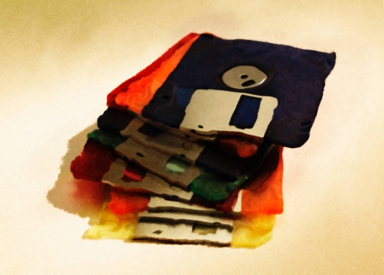
Waterfall Model Phases
Phase 3. Implementation and unit testing
Implementation: Executable code
Unit testing (Component test)
Individual components (function/programs/classes) are tested independently;
Components may be functions or objects or coherent groupings of these entities.
Phase 3

Slide 12
Waterfall Model Phases
Phase 4. Integration and system testing
System testing
Integration Testing of the units and system as a whole.
Testing of emergent properties is particularly important (e.g. performance, security, etc)
Acceptance testing
Testing with customer data to check that the system meets the customer’s needs.
Phase 4

Slide 13
Waterfall Model Phases
Phase 5. Operation and maintenance
Deployment of the software
Continuous testing and maintenance triggered by the community
Trigger for software evolution:
New features, evolved versions
Phase 5

Slide 14

Evolutionary Development
Exploratory development
Objective is to work with customers and to evolve a final system from an initial outline specification.
Start with well-understood requirements and add new features as proposed by the customer (i.e. incremental)
Throw-away prototyping
Objective is to understand the system requirements. Should start with poorly understood requirements to clarify what is really needed.

Slide 15

Evolutionary Development

Slide 16
Process Iteration
System requirements ALWAYS evolve in the course of a project so process iteration where earlier stages are reworked is always part of the process for large systems
Iteration can be applied to any of the generic process models (e.g., waterfall)
Two (related) approaches
Incremental delivery;
Spiral development.

Slide 17
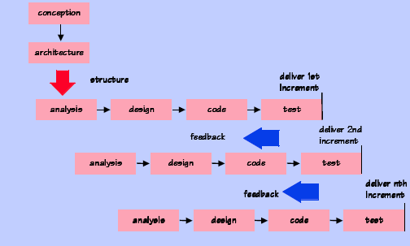
Incremental Development
Reference: A. Finkelstein

Slide 18
Incremental Delivery
Rather than deliver the system as a single delivery,
the development and delivery is broken down into increments with each increment delivering part of the required functionality (i.e., Agile practices)
User requirements are prioritised
highest priority requirements are included in early increments
Once the development of an increment is started, the requirements are frozen though requirements for later increments can continue to evolve

Slide 19
Incremental Development Advantages
Early increments act as a prototype to help elicit requirements for later increments
Lower risk of overall project failure
The highest priority system services tend to receive the most testing
Customer value can be delivered with each increment so system functionality is available earlier

Slide 20
Spiral Development
Process is represented as a spiral rather than as a sequence of activities with backtracking
Each loop in the spiral represents a phase in the process
No fixed phases such as specification or design - loops in the spiral are chosen depending on what is required.
Risks are explicitly assessed and resolved throughout the process
Several prototypes are built as part of the process

Slide 21
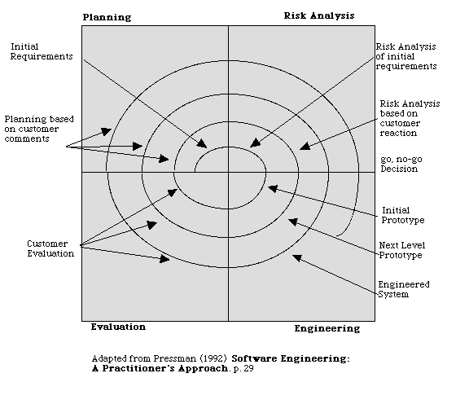
Spiral Model

Slide 22
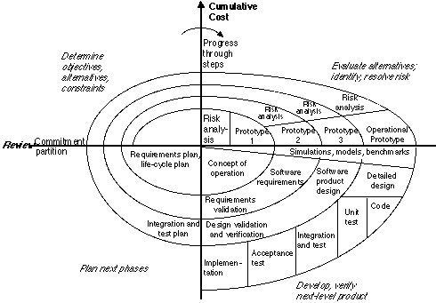
Spiral Model

Slide 23
Spiral Model Sectors
Objective setting
Specific objectives for the phase are identified.
Risk assessment and reduction
Risks are assessed and activities put in place to reduce the key risks
Development and validation
A development model for the system is chosen which can be any of the generic models
Planning
The project is reviewed and the next phase of the spiral is planned

Slide 24
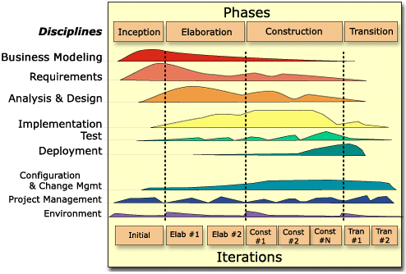
RUP Model

Slide 25
RUP- Phases
Inception
Establish the business case for the system
Elaboration
Develop an understanding of the problem domain and the system architecture
Construction
System design, programming and testing
Transition
Deploy the system in its operating environment
All the disciplines(e.g., requirements, architecture, testing etc) are revisited along the above phases but with varying magnitude

Slide 26
Modern Software Models: Agile, Scrum
Learn Scrum in 10 minutes
Link to Scrum in 10 minutes (Links to an external site.)
Video 2: A visit to Microsoft Labs Seattle (Agile)
Scrum in Practice Microsoft Labs Seattle (Links to an external site.)
Agile, Scrum, DevOps are often referred to as culture and developers’ focused
More coverage on Agile process/culture as part of the Software Management section of the module – Week 5/6

Slide 27
Modern Software Models: Agile
Video 1: Agile Software Development with Fowler and Neil Ford
Explaining Agile - Martin Fowler and Neil Ford at USI (Links to an external site.)
Video 2. What is Agile
What is Agile? (Links to an external site.)

Slide 28
Modern Software Models: DevOps
Introduction to DevOps by Rackspace - Light Introduction
DevOps introduction by Rackspace (Links to an external site.)

Slide 29
Summary
Software processes are the activities involved in producing and evolving a software system
Software process models are abstract representations of these processes
General activities are specification, design and implementation, validation and evolution
Generic process models describe the organisation of software processes. Examples include the waterfall model, evolutionary development and component-based software engineering
Iterative process models describe the software process as a cycle of activities
The Rational Unified Process is a generic process model that separates activities from phases
Scrum and DevOps are modern agile models

